Slide 1
Murach’s PHP and MySQL (4th Edition)
Chapter 12
How to work with cookies and sessions

Slide 2
Objectives
Applied
Use any of the functions and techniques presented in this chapter as you use cookies and session tracking in your applications.
Knowledge
Describe the use of cookies, and distinguish between session and persistent cookies.
Describe the use of session tracking.
Describe the use of the $_COOKIE and $_SESSION variables.
Describe the use of the functions for working with cookies and sessions.

Slide 3
Examples of cookies
PHPSESSID=D1F15245171203E8670487F020544490
user_id=87
email=jsmith@hotmail.com

Slide 4
How cookies work
A cookie is a name/value pair that is stored in a browser.
On the server, a web application creates a cookie and sends it to the browser.
On the client, the browser saves the cookie and sends it back to the server every time it accesses a page from that server.
By default, cookies only last until the user closes their web browser. However, cookies can be set to persist in the user’s browser until a specified expiration date.
Some users disable cookies in their browsers.
Browsers generally accept only 20 cookies from each site and 300 cookies total.
Browsers can also limit each cookie to 4 kilobytes.
A cookie can be associated with one or more subdomain names.

Slide 5
Typical uses for cookies
To allow users to skip login and registration forms that gather data like username, password, address, or credit card data.
To customize pages that display information like weather reports, sports scores, and stock quotations.
To focus advertising like banner ads that target the user’s interests.

Slide 6
The syntax of the setcookie() function
setcookie($name, $value, $expire, $path,
$domain, $secure, $httponly)
Set a cookie in the browser
$name = 'userid';
$value = '87';
$expire = new DateTime('+1 year');
$path = '/';
setcookie($name, $value, $expire, $path);
Get the value of a cookie from the browser
$userid = filter_input(INPUT_COOKIE, 'userid',
FILTER_VALIDATE_INT);
Delete a cookie from the browser
$expire = new DateTime('-1 year');
setcookie('userid', '', $expire, '/');

Slide 7
Key terms related to cookies
cookie
session cookie
persistent cookie

Slide 8
How to enable or disable cookies in Chrome
Open the “Customize and control Google Chrome” menu.
Select the Settings item.
Click on the link to the “Privacy and security” section.
In the “Privacy and security” section, click on the “Cookies and other site data” link.
Select the “Allow all cookies” option to enable cookies or the “Block all cookies” option to disable cookies.

Slide 9
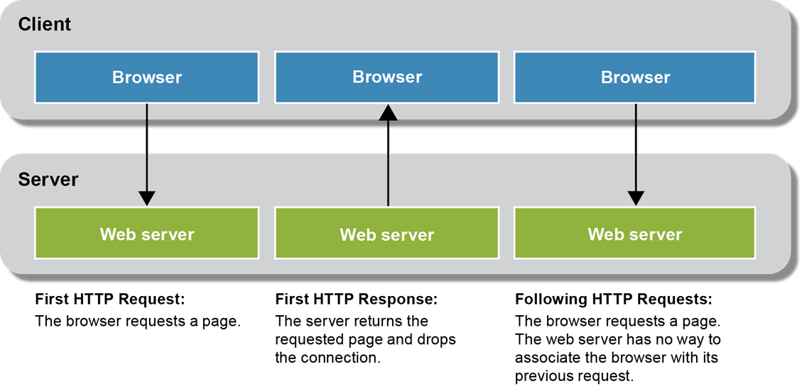
Why session tracking is difficult with HTTP

Slide 10
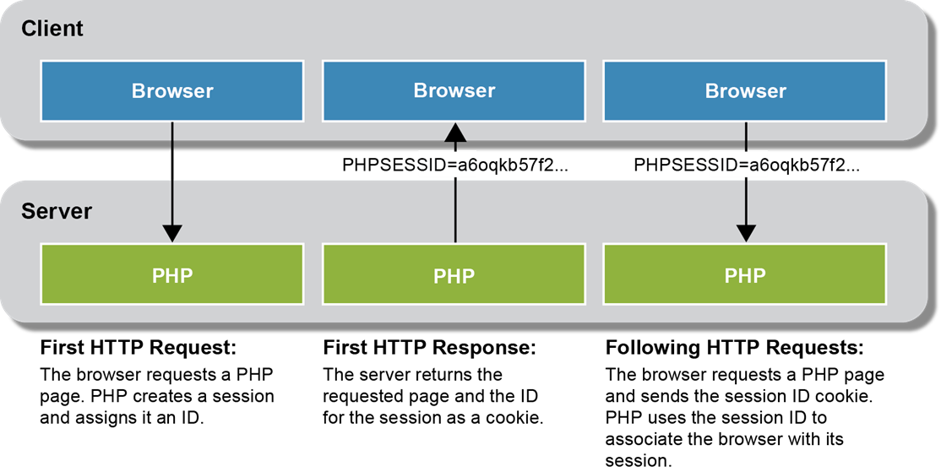
How PHP keeps track of sessions

Slide 11
Key terms related to session tracking
state
stateless protocol
session tracking
URL encoding

Slide 12
A function to start a session
session_start()
Start a session with the default cookie parameters
session_start();
Check if session is already started
if (session_status() == PHP_SESSION_NONE) {
session_start();
}

Slide 13
The session_set_cookie_params() function
session_set_cookie_params($lifetime, $path, $domain,
$secure, $httponly])
Start a session with custom cookie parameters
$lifetime = 60 * 60 * 24 * 365; // 1 year in seconds
session_set_cookie_params($lifetime, '/');
session_start();

Slide 14
How to set and get scalar variables
Set a variable in a session
$_SESSION['product_code'] = 'MBT-1753';
Get a variable from a session
$product_code = $_SESSION['product_code'];

Slide 15
How to set and get arrays
Set an array in a session
if (!isset($_SESSION['cart'])) {
$_SESSION['cart'] = [];
}
Add an element to an array that’s stored in a session
$_SESSION['cart']['key1'] = 'value1';
$_SESSION['cart']['key2'] = 'value2';
Get and use an array that’s stored in a session
$cart = $_SESSION['cart'];
foreach ($cart as $item) {
echo '<li>' . $item . '</li>';
}

Slide 16
How to remove variables from a session
Remove a session variable
unset($_SESSION['cart']);
Remove all session variables
$_SESSION = [];

Slide 17
Functions to manage sessions
session_name()
session_id([$id])
session_regenerate_id()
session_write_close()
Get the name of the session cookie
$name = session_name(); // By default, PHPSESSID
Get the value of the session ID
$id = session_id();
Set the session ID
session_id('abc123');

Slide 18
A function to end a session
session_destroy()
End a session
$_SESSION = []; // Clear session data from memory
session_destroy(); // Clean up the session ID

Slide 19
Delete the session cookie from the browser
// Get name of session cookie
$name = session_name();
// Create expire date in the past
$expire = new DateTime('-1 year');
// Get session params
$params = session_get_cookie_params();
$path = $params['path'];
$domain = $params['domain'];
$secure = $params['secure'];
$httponly = $params['httponly'];
setcookie($name, '', $expire, $path, $domain,
$secure, $httponly);

Slide 20
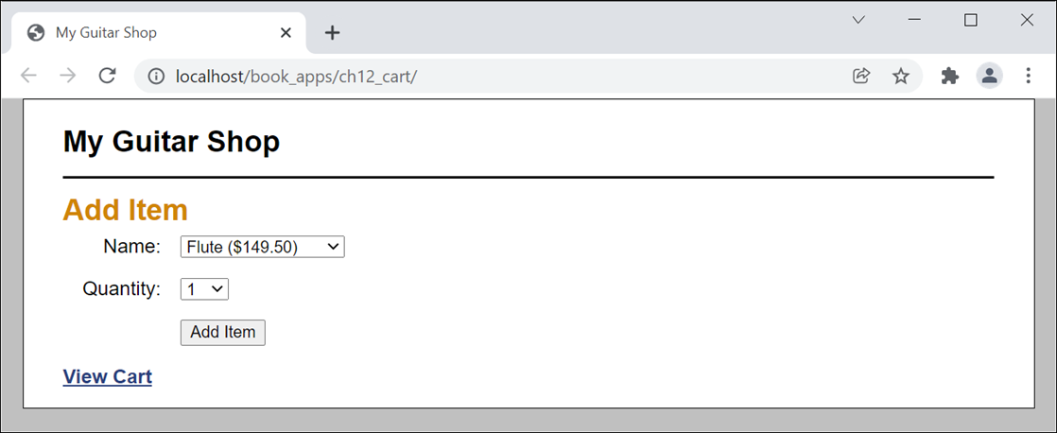
The Add Item page

Slide 21
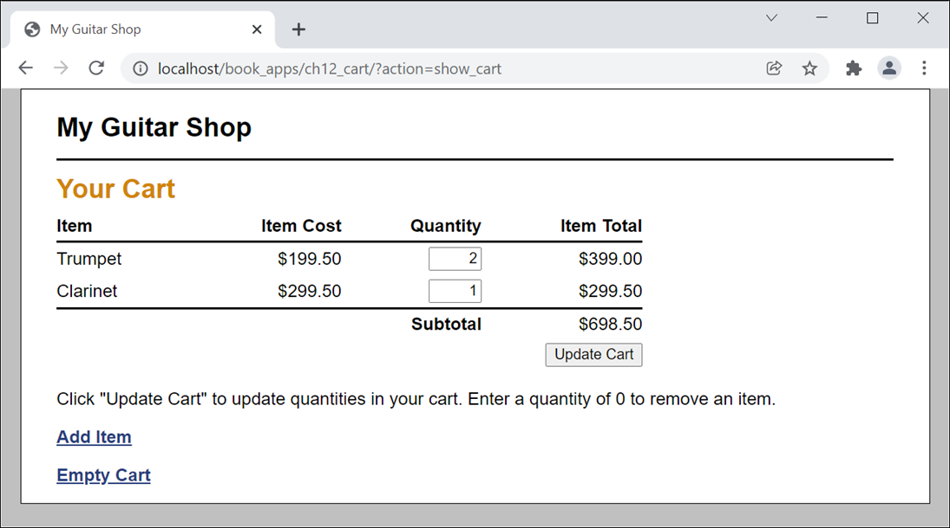
The Cart page

Slide 22
The index.php file (part 1)
<?php
require_once('cart.php');
// Start session management with a persistent cookie
$lifetime = 60 * 60 * 24 * 14; // 2 weeks in seconds
session_set_cookie_params($lifetime, '/');
session_start();
// Create a cart array if needed
if (empty($_SESSION['cart12'])) { $_SESSION['cart12'] = []; }
// Create a table of products
$products = [
'MMS-1754' => ['name' => 'Flute', 'cost' => '149.50'],
'MMS-6289' => ['name' => 'Trumpet', 'cost' => '199.50'],
'MMS-3408' => ['name' => 'Clarinet', 'cost' => '299.50'],
];

Slide 23
The index.php file (part 2)
$action = filter_input(INPUT_POST, 'action');
if ($action === NULL) {
$action = filter_input(INPUT_GET, 'action');
if ($action === NULL) {
$action = 'show_add_item';
}
}
switch($action) {
case 'add':
$product_key = filter_input(INPUT_POST, 'productkey');
$item_qty = filter_input(INPUT_POST, 'itemqty');
$product = $products[$product_key];
add_item($product_key, $item_qty, $product);
header("Location: .?action=show_cart");
break;

Slide 24
The index.php file (part 3)
case 'update':
$new_qty_list = filter_input(INPUT_POST, 'newqty',
FILTER_DEFAULT, FILTER_REQUIRE_ARRAY);
foreach($new_qty_list as $key => $qty) {
if ($_SESSION['cart12'][$key]['qty'] != $qty) {
update_item($key, $qty);
}
}
header("Location: .?action=show_cart");
break;
case 'show_cart':
include('cart_view.php');
break;
case 'show_add_item':
include('add_item_view.php');
break;
case 'empty_cart':
unset($_SESSION['cart12']);
include('cart_view.php');
break;
}
?>

Slide 25
The cart.php file (part 1)
<?php
// Add an item to the cart
function add_item($key, $quantity, $product) {
if ($quantity > 0) {
// If item already exists in cart, update quantity
if (isset($_SESSION['cart12'][$key])) {
$quantity += $_SESSION['cart12'][$key]['qty'];
update_item($key, $quantity);
} else {
// Add item
$item = [
'name' => $product['name'],
'cost' => $product['cost'],
'qty' => $quantity,
'total' => $product['cost'] * $quantity,
];
$_SESSION['cart12'][$key] = $item;
}
}
}

Slide 26
The cart.php file (part 2)
// Update an item in the cart
function update_item($key, $quantity) {
$quantity = (int) $quantity;
if (isset($_SESSION['cart12'][$key])) {
// if quantity is less than zero, remove item
if ($quantity <= 0) {
unset($_SESSION['cart12'][$key]);
} else {
// update item
$_SESSION['cart12'][$key]['qty'] = $quantity;
$total = $_SESSION['cart12'][$key]['cost'] *
$_SESSION['cart12'][$key]['qty'];
$_SESSION['cart12'][$key]['total'] = $total;
}
}
}

Slide 27
The cart.php file (part 3)
// Get cart subtotal
function get_subtotal() {
$subtotal = 0;
foreach ($_SESSION['cart12'] as $item) {
$subtotal += $item['total'];
}
$subtotal_f = number_format($subtotal, 2);
return $subtotal_f;
}
?>

Slide 28
The add_item_view.php file (part 1)
<!DOCTYPE html>
<html>
<head>
<title>My Guitar Shop</title>
<link rel="stylesheet" href="main.css">
</head>
<body>
<header>
<h1>My Guitar Shop</h1>
</header>
<main>
<h1>Add Item</h1>

Slide 29
The add_item_view.php file (part 2)
<form action="." method="post">
<input type="hidden" name="action" value="add">
<label>Name:</label>
<select name="productkey">
<?php foreach($products as $key => $product) :
$cost = number_format($product['cost'], 2);
$name = $product['name'];
$item = $name . ' ($' . $cost . ')';
?>
<option value="<?php echo $key; ?>">
<?php echo $item; ?>
</option>
<?php endforeach; ?>
</select><br>

Slide 30
The add_item_view.php file (part 3)
<label>Quantity:</label>
<select name="itemqty">
<?php for($i = 1; $i <= 10; $i++) : ?>
<option value="<?php echo $i; ?>">
<?php echo $i; ?>
</option>
<?php endfor; ?>
</select><br>
<label>&nbsp;</label>
<input type="submit" value="Add Item">
</form>
<p><a href=".?action=show_cart">View Cart</a></p>
</main>
</body>
</html>

Slide 31
The cart_view.php file (part 1)
<!DOCTYPE html>
<html>
<head>
<title>My Guitar Shop</title>
<link rel="stylesheet" href="main.css">
</head>
<body>
<header>
<h1>My Guitar Shop</h1>
</header>
<main>

Slide 32
The cart_view.php file (part 2)
<h1>Your Cart</h1>
<?php if (empty($_SESSION['cart12']) ||
count($_SESSION['cart12']) == 0) : ?>
<p>There are no items in your cart.</p>
<?php else: ?>
<form action="." method="post">
<input type="hidden" name="action"
value="update">
<table>
<tr id="cart_header">
<th class="left">Item</th>
<th class="right">Item Cost</th>
<th class="right">Quantity</th>
<th class="right">Item Total</th>
</tr>

Slide 33
The cart_view.php file (part 3)
<?php foreach(
$_SESSION['cart12'] as $key => $item ) :
$cost = number_format($item['cost'], 2);
$total = number_format($item['total'], 2);
?>
<tr>
<td><?php echo $item['name']; ?></td>
<td class="right">
$<?php echo $cost; ?></td>
<td class="right">
<input type="text" class="cart_qty"
name="newqty[<?php
echo $key; ?>]"
value="<?php
echo $item['qty']; ?>">
</td>
<td class="right">
$<?php echo $total; ?></td>
</tr>
<?php endforeach; ?>

Slide 34
The cart_view.php file (part 4)
<tr id="cart_footer">
<td colspan="3"><b>Subtotal</b></td>
<td>$<?php echo get_subtotal(); ?></td>
</tr>
<tr>
<td colspan="4" class="right">
<input type="submit"
value="Update Cart"></td>
</tr>
</table>
<p>Click "Update Cart" to update quantities in
your cart. Enter a quantity of 0 to remove
an item.</p>
</form>
<?php endif; ?>
<p><a href=".?action=show_add_item">Add Item</a></p>
<p><a href=".?action=empty_cart">Empty Cart</a></p>
</main>
</body>
</html>

